Slide 1

IT314 : SOFTWARE ENGINEERING
Final Presentation
Topic: Social Media App Like Instagram, Facebook
Professor - Dr. JayPrakash Lalchandani
Mentor TA : Harshal

Slide 2
InstaHUB
We Connect The World

Slide 3
Team Members
Name | ID
Kunjkumar Modi | 201901126
Nevilkumar Dalsania | 201901013
Meet Prajapati | 201901025
Heli Dhimmar | 201901106
Dwij Bhanderi | 201901168
Nilay Ghodasara | 201901169

Slide 4
Context Diagram

Slide 5
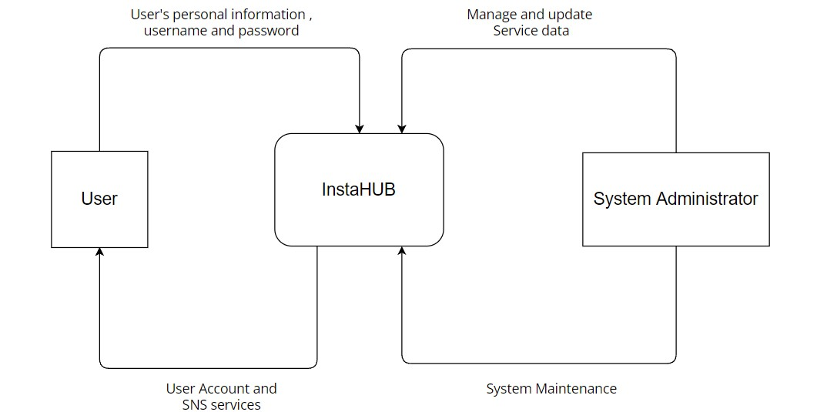

Slide 6
Functional Summary (User Stories)
Users can signup by entering the valid credentials and profile photo which will be saved directly into the database.
Users can login to the website through their email and password which will be checked into the database, if it will be correct then website will login the user by creating a session for that user.
A user can also create a post by adding title, body and a picture for the post whose data will be stored into the database.

Slide 7
Functional Summary (User Stories) – (Contd.)
Users can also like and comment to the other users posts which are shown on the home page.
Users can follow and unfollow other users by just going to their profile page.
Users can also logout from the website if they don’t want to continue using the website.
Users can also update their profile photo by going to their profile page.

Slide 8
Top level Use Case Model

Slide 9
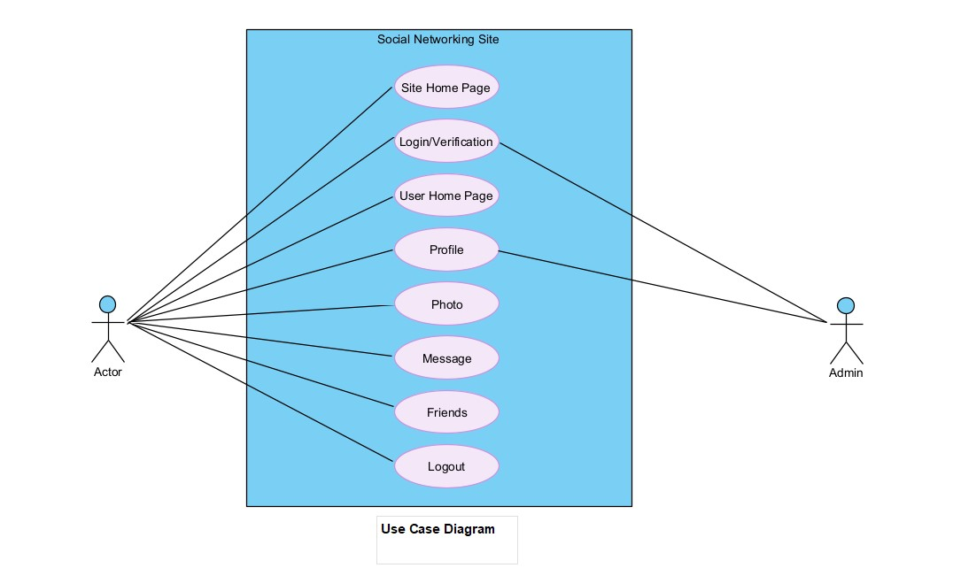

Slide 10
Sequence Diagram

Slide 11
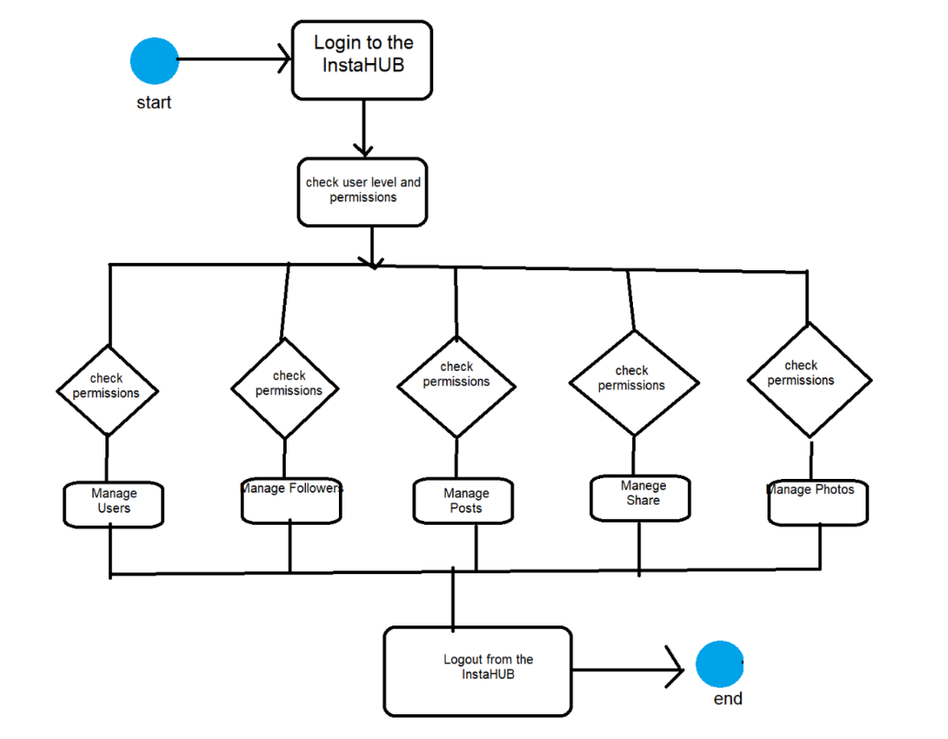

Slide 12
Activity Diagram

Slide 13
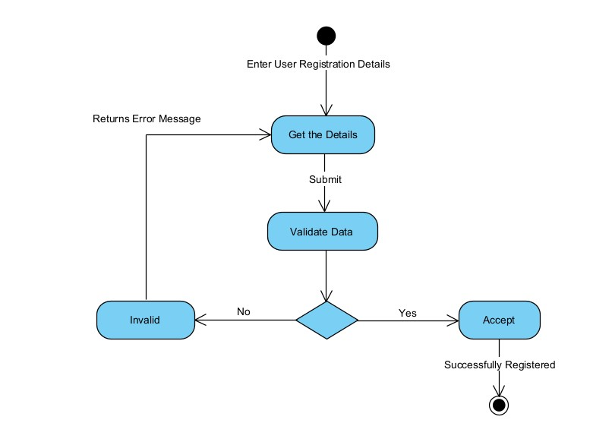

Slide 14
Deployment Diagram

Slide 15
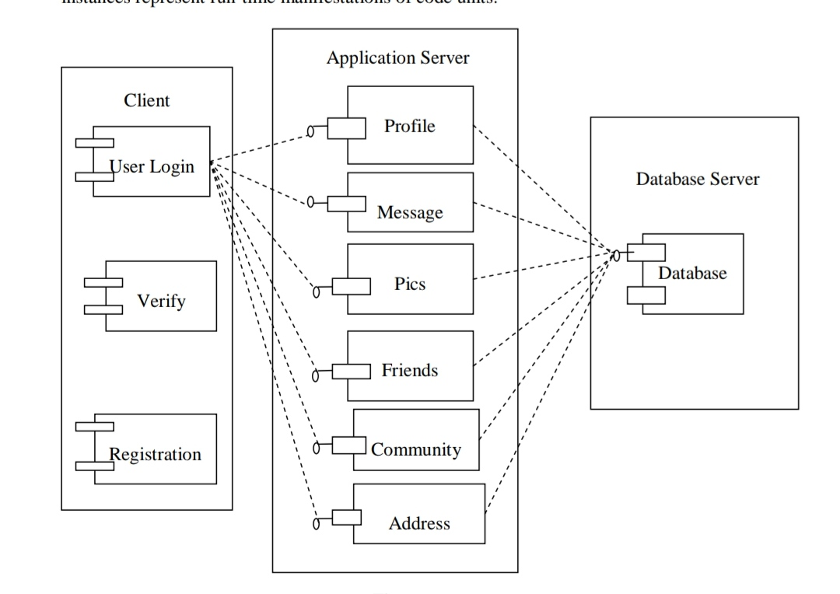

Slide 16
Class Diagram

Slide 17
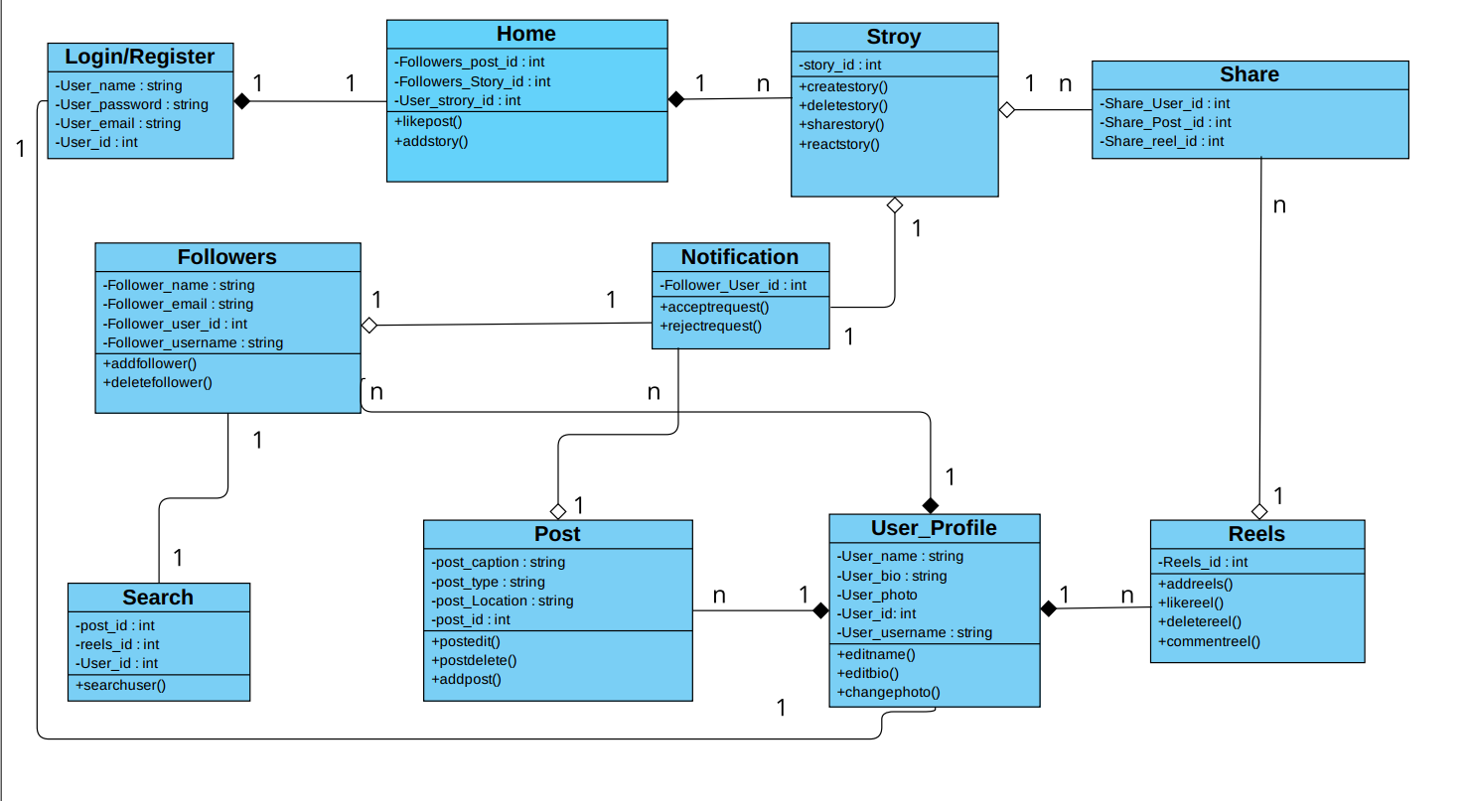

Slide 18
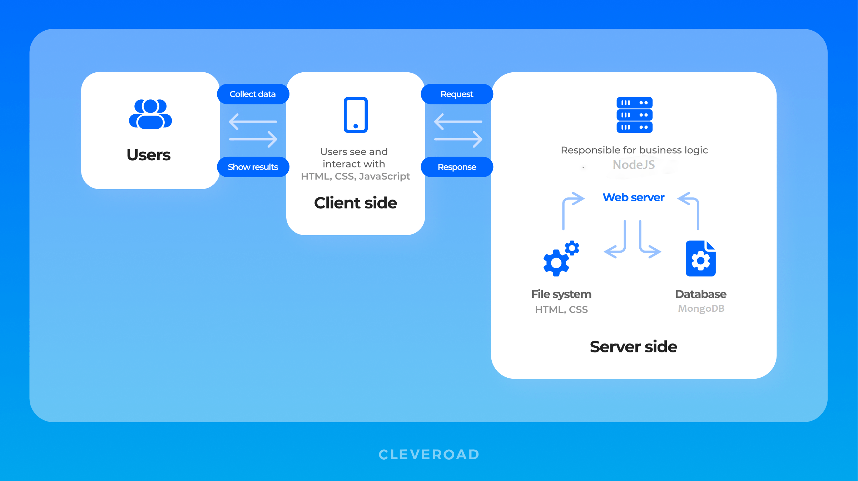
Application Architecture

Slide 19
Technology/Tools and Libraries
We have used ReactJS for the frontend which is completely based on the JavaScript as it is a JavaScript based frontend framework.
For the designing purpose we have used CSS i.e. Cascading Style Sheet.
For the backend, we have used NodeJS and ExpressJS which is also a JavaScript based backend language.
For storing the various user data, we have used MongoDB Atlas which indeed will be connected to the NodeJS for fetching and saving the data.
Authentication is implemented with the help of an external JsonWebToken npm package.
For having a better performance in image retrieval and storage, we have used Cloudinary which is a online service platform for storing images and videos.

Slide 20
Summary of Implementation
We have fully implemented the necessary functionalities in our website.
We have a full proof working authentication where user can login and sign up which is implemented with a help of the JSON webtoken npm package.
In our website on the Home page, we can see all users posts and we can also like and comment to any of the post..

Slide 21
Summary of Implementation - (Contd.)
We also have profile page for all users where we can visit and can see the profile of them and can also follow – unfollow them.
We can also update our profile photo by just going to our profile where we will be able to see the button to update our profile photo.
We have also implemented a my followings page where we can only see the posts of the users whom we are following

Slide 22
Individual Contribution
Name | Contribution
Kunjkumar Modi | Logo design, SRS, Login and Signup page design, database schema
Nevilkumar Dalsania | Authentication, Like and Comment functionalities, API creation
Meet Prajapati | SRS preparation and verification, DFD, Home and My followings page,
Heli Dhimmar | Signup page design, Profile Page, DFD and other diagrams,
Dwij Bhanderi | Added CSS, SRS, Home Page Design, diagrams, Create post page
Nilay Ghodasara | Home page, SRS, Profile Page, changing profile photo functionality

Slide 23
Gantt chart

Slide 24
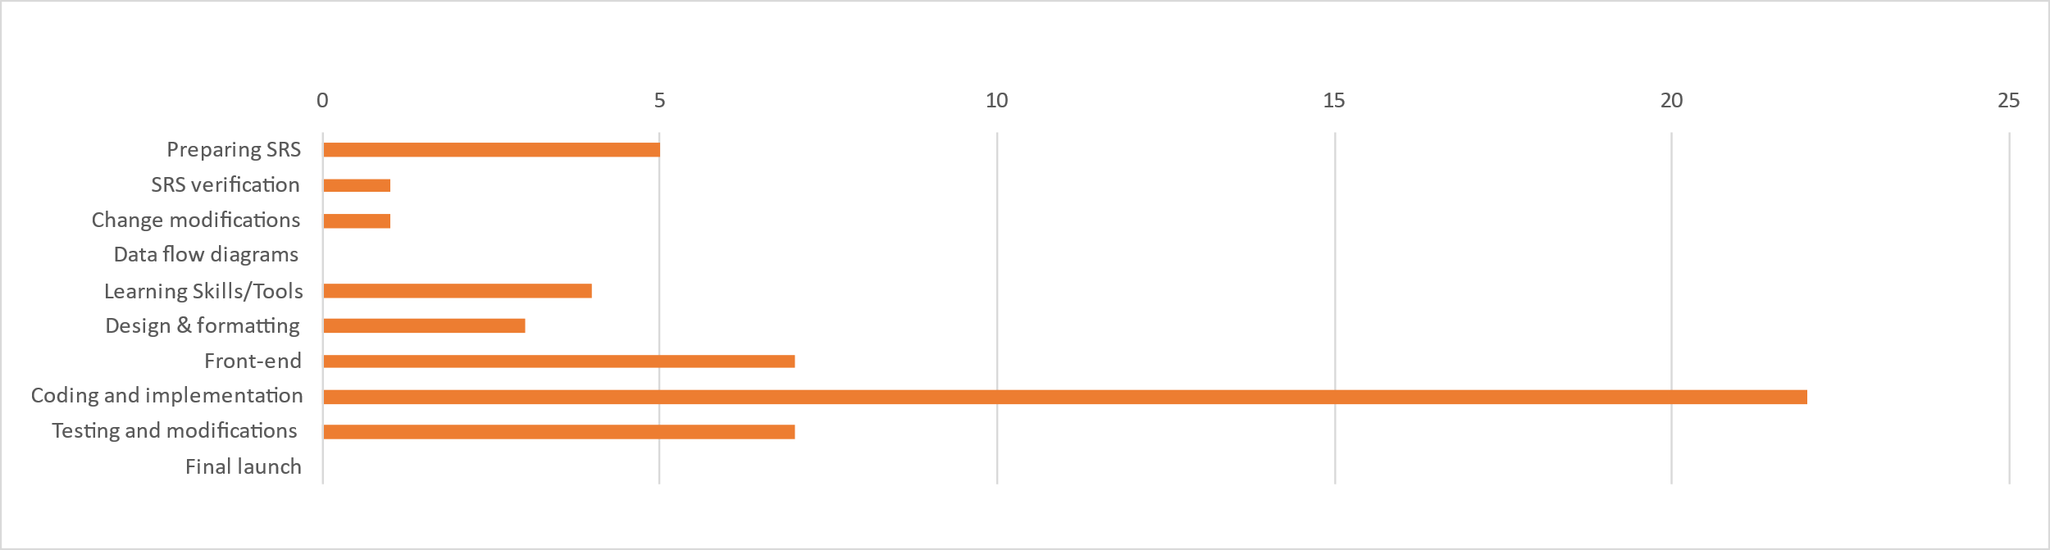

Slide 25
Application Navigation

Slide 26
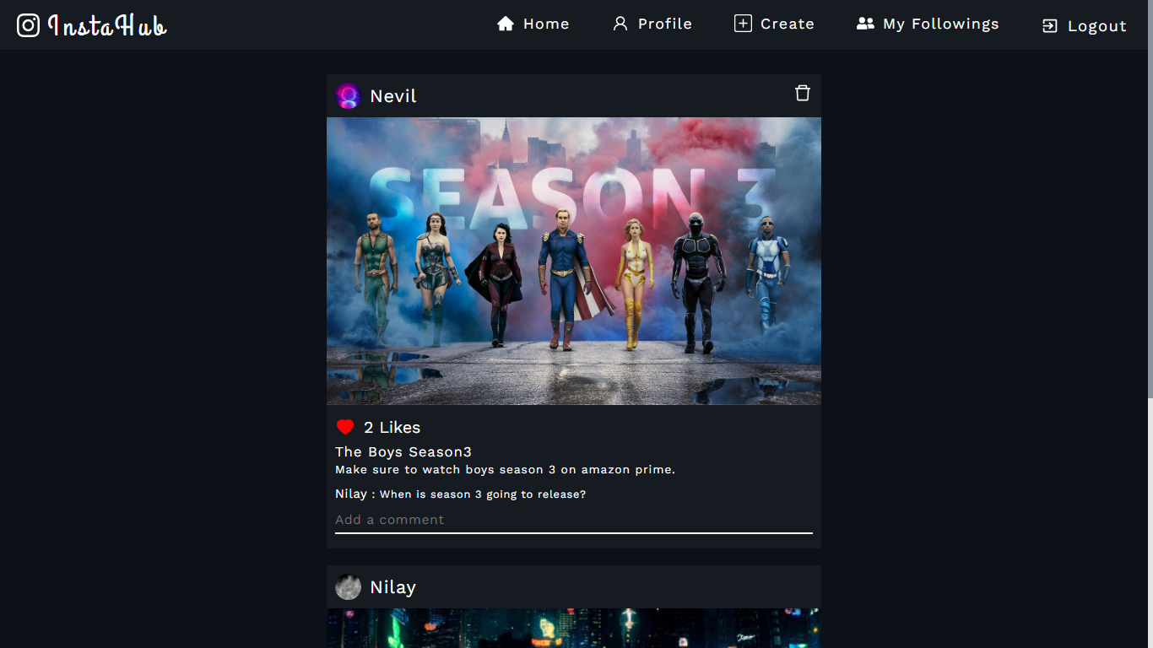
Home Page

Slide 27
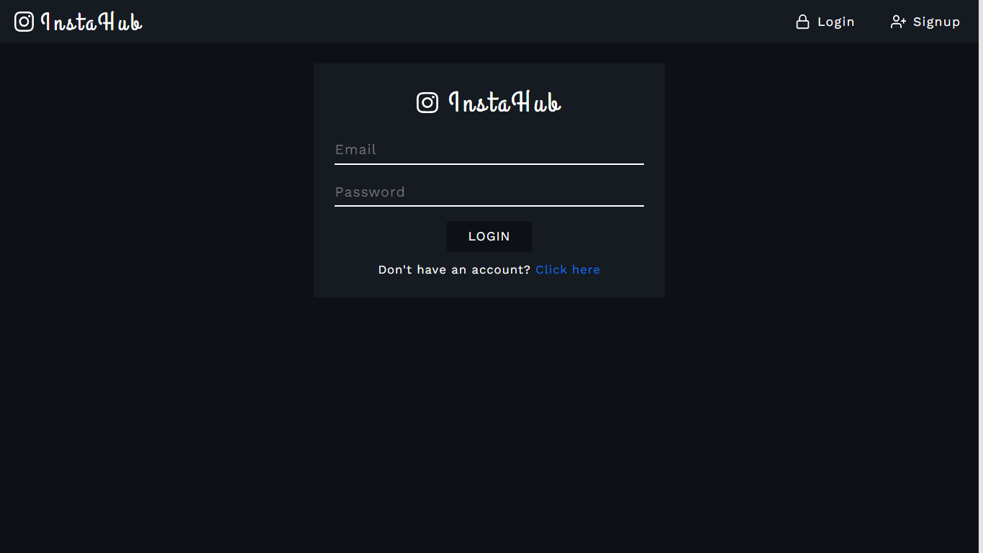
Login Page

Slide 28
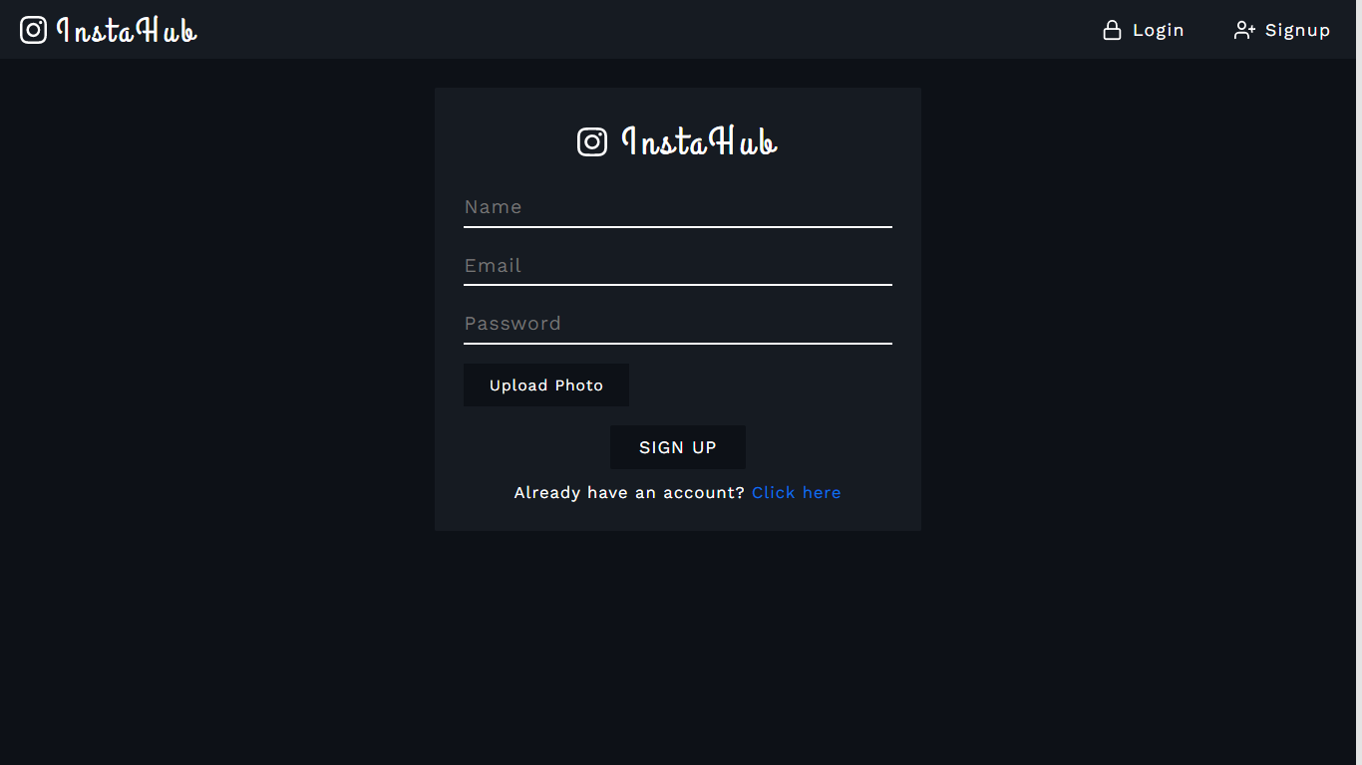
Signup Page

Slide 29
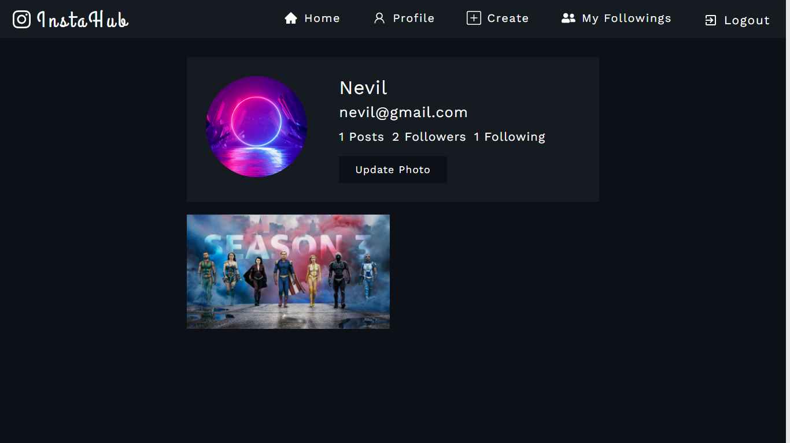
Profile Page

Slide 30
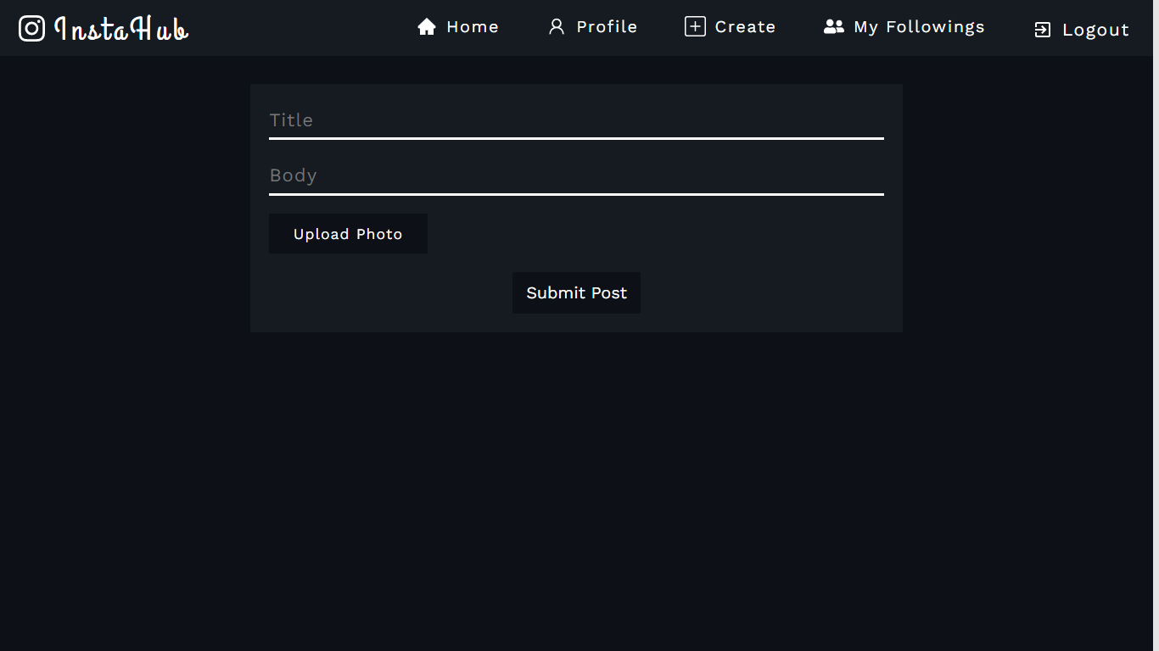
Post creation Page

Slide 31
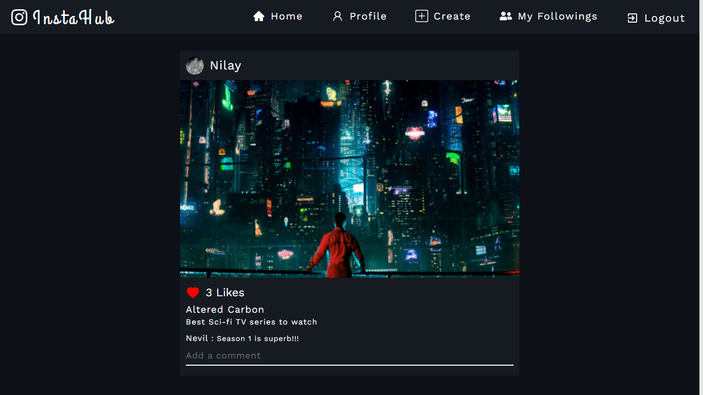
My Followings Page

Slide 32
Test Planning /Future Plan
We have completely implemented all the functionalities that were necessary and were decided to be implemented after the midterm presentation.
We have carried out all the necessary tests for our website so that we can minimize the bug that a user will face while using our website.
In the future, we will try to optimize the response time of the implemented functionalities so that users don’t have to wait longer for the response to come.
We have also done BLACK BOX TESTING for all the individual components that we have created for our website. So that our website doesn’t behave differently for some edge cases.
After doing Black box testing, we found no error and all functionalities are working correctly.

Slide 33
Thank You

